Slide 1
8
Pointers and
Pointer-Based
Strings

Slide 2
Addresses are given to us to conceal our whereabouts.
  Saki (H. H. Munro)
By indirection find direction out.
  William Shakespeare
Many things, having full reference
To one consent, may work contrariously.
  William Shakespeare
You will find it a very good practice always to verify your references, sir!
  Dr. Routh

Slide 3
OBJECTIVES
In this chapter you will learn:
What pointers are.
The similarities and differences between pointers and references and when to use each.
To use pointers to pass arguments to functions by reference.
To use pointer-based C-style strings.
The close relationships among pointers, arrays and C-style strings.
To use pointers to functions.
To declare and use arrays of C-style strings.

Slide 4
8.1 Introduction
8.2 Pointer Variable Declarations and Initialization
8.3 Pointer Operators
8.4 Passing Arguments to Functions by Reference with Pointers
8.5 Using const with Pointers
8.6 Selection Sort Using Pass-by-Reference
8.7 sizeof Operators
8.7 Pointer Expressions and Pointer Arithmetic
8.9 Relationship Between Pointers and Arrays
8.10 Arrays of Pointers
8.11 Case Study: Card Shuffling and Dealing Simulation
8.12 Function Pointers
8.13 Introduction to Pointer-Based String Processing
8.13.1 Fundamentals of Characters and Pointer-Based Strings
8.13.2 String Manipulation Functions of the String-Handling Library
8.14 Wrap-Up

Slide 5
8.1 Introduction
Pointers
  Powerful, but difficult to master
  Can be used to perform pass-by-reference
  Can be used to create and manipulate dynamic data structures
  Close relationship with arrays and strings
    char * pointer-based strings

Slide 6
8.2 Pointer Variable Declarations and Initialization
Pointer variables
  Contain memory addresses as values
    Normally, variable contains specific value (direct reference)
    Pointers contain address of variable that has specific value (indirect reference)
Indirection
  Referencing value through pointer

Slide 7
8.2 Pointer Variable Declarations and Initialization (Cont.)
Pointer declarations
  * indicates variable is a pointer
    Example
      int *myPtr;
        Declares pointer to int, of type int *
    Multiple pointers require multiple asterisks
      int *myPtr1, *myPtr2;
Pointer initialization
  Initialized to 0, NULL, or an address
    0 or NULL points to nothing (null pointer)

Slide 8
Common Programming Error 8.1
Assuming that the * used to declare a pointer distributes to all variable names in a declaration’s comma-separated list of variables can lead to errors. Each pointer must be declared with the * prefixed to the name (either with or without a space in between—the compiler ignores the space). Declaring only one variable per declaration helps avoid these types of errors and improves program readability.

Slide 9
Good Programming Practice 8.1
Although it is not a requirement, including the letters Ptr in pointer variable names makes it clear that these variables are pointers and that they must be handled appropriately.

Slide 10
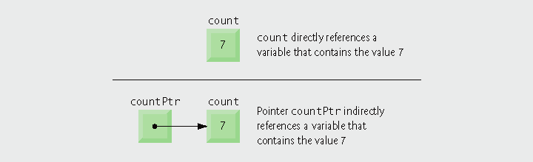
Fig. 8.1 | Directly and indirectly referencing a variable.

Slide 11
Error-Prevention Tip 8.1
Initialize pointers to prevent pointing to unknown or uninitialized areas of memory.

Slide 12
8.3 Pointer Operators
Address operator (&)
  Returns memory address of its operand
  Example
    int y = 5;
    int *yPtr;
    yPtr = &y;
    assigns the address of variable y to pointer variable yPtr
      Variable yPtr “points to” y
        yPtr indirectly references variable y’s value

Slide 13

Fig. 8.2 | Graphical representation of a pointer pointing to a variable in memory.

Slide 14
8.3 Pointer Operators (Cont.)
* operator
  Also called indirection operator or dereferencing operator
  Returns synonym for the object its operand points to
  *yPtr returns y (because yPtr points to y)
  Dereferenced pointer is an lvalue
      *yptr = 9;
* and & are inverses of each other
  Will “cancel one another out” when applied consecutively in either order

Slide 15

Fig. 8.3 | Representation of y and yPtr in memory.

Slide 16
Common Programming Error 8.2
Dereferencing a pointer that has not been properly initialized or that has not been assigned to point to a specific location in memory could cause a fatal execution-time error, or it could accidentally modify important data and allow the program to run to completion, possibly with incorrect results.

Slide 17
Common Programming Error 8.3
An attempt to dereference a variable that is not a pointer is a compilation error.

Slide 18
Common Programming Error 8.4
Dereferencing a null pointer is normally a fatal execution-time error.

Slide 19
Portability Tip 8.1
The format in which a pointer is output is compiler dependent. Some systems output pointer values as hexadecimal integers, while others use decimal integers.

Slide 20
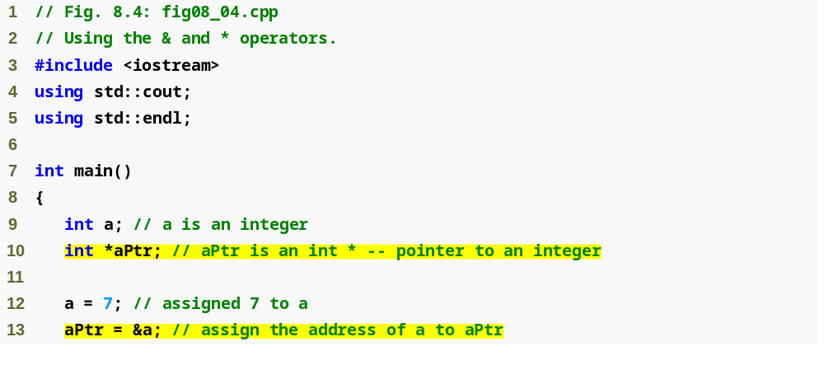
Outline
fig08_04.cpp
(1 of 2)
Variable aPtr is a point to an int
Initialize aPtr with the address of variable a

Slide 21
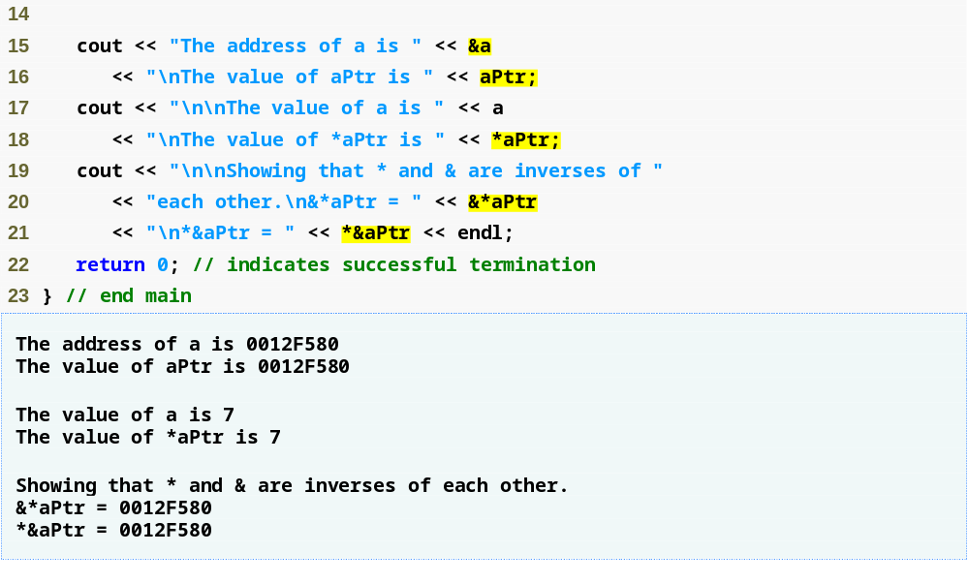
Outline
Address of a and the value of aPtr are identical
Value of a and the dereferenced aPtr are identical
fig08_04.cpp
(2 of 2)
* and & are inverses of each other
* and & are inverses; same result when both are applied to aPtr

Slide 22
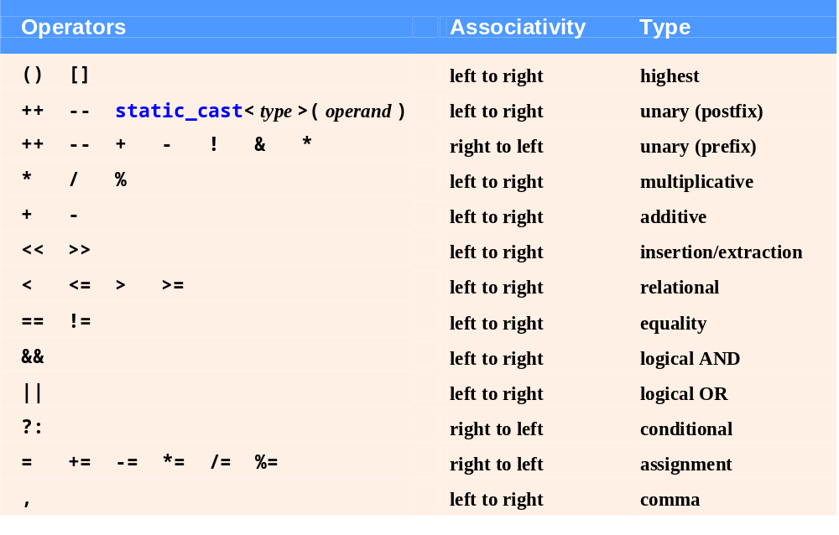
Fig. 8.5 | Operator precedence and associativity.

Slide 23
8.4 Passing Arguments to Functions by Reference with Pointers
Three ways to pass arguments to a function
  Pass-by-value
  Pass-by-reference with reference arguments
  Pass-by-reference with pointer arguments
A function can return only one value
Arguments passed to a function using reference arguments
  Function can modify original values of arguments
    More than one value “returned”

Slide 24
8.4 Passing Arguments to Functions by Reference with Pointers (Cont.)
Pass-by-reference with pointer arguments
  Simulates pass-by-reference
    Use pointers and indirection operator
  Pass address of argument using & operator
  Arrays not passed with & because array name is already a pointer
  * operator used as alias/nickname for variable inside of function

Slide 25
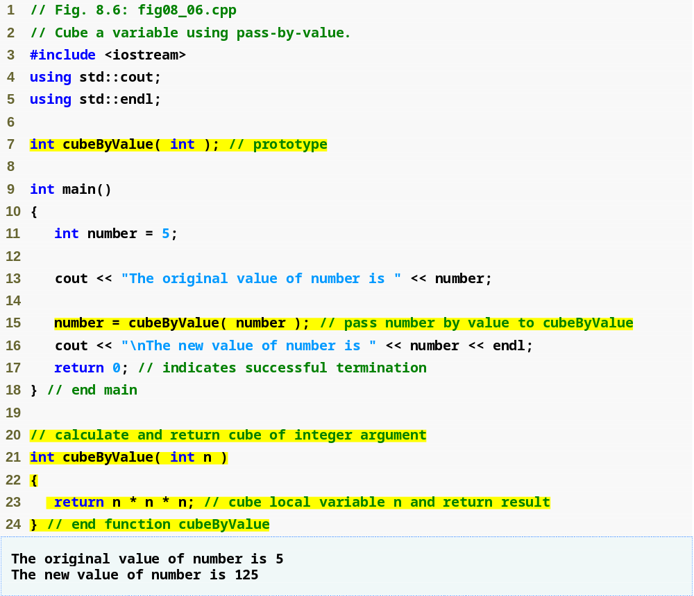
Outline
fig08_06.cpp
(1 of 1)
Pass number by value; result returned by cubeByValue
cubeByValue receives parameter passed-by-value
Cubes local variable n
and return the result

Slide 26
Common Programming Error 8.5
Not dereferencing a pointer when it is necessary to do so to obtain the value to which the pointer points is an error.

Slide 27
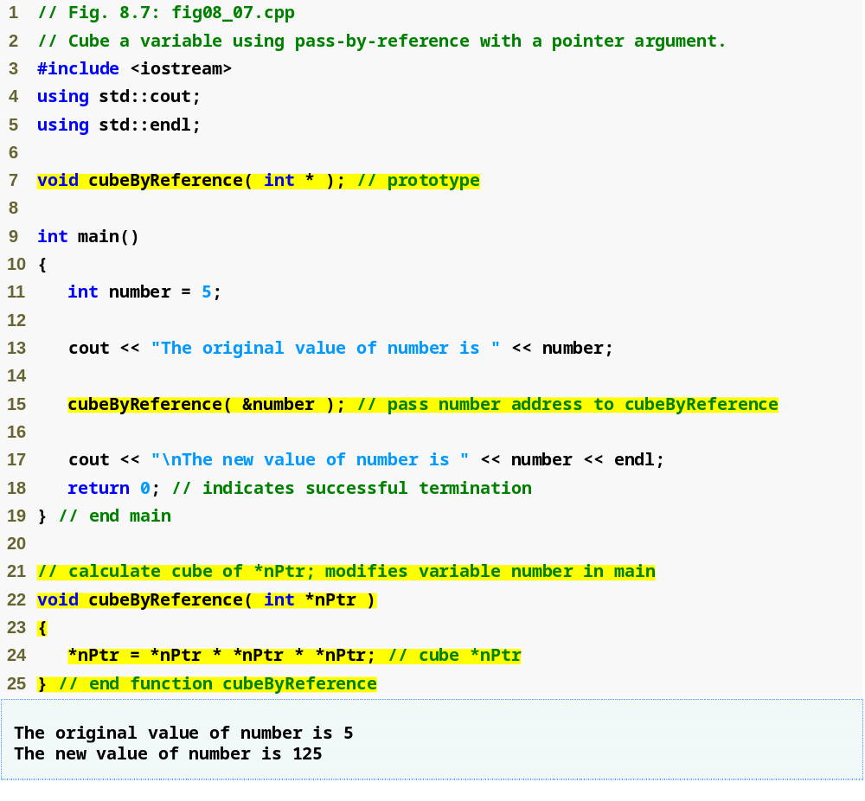
Outline
Prototype indicates parameter is a pointer to an int
fig08_07.cpp
(1 of 1)
Apply address operator & to pass address of number to cubeByReference
cubeByReference modifies variable number
Modify and access int variable using indirection operator *
cubeByReference receives address of an int variable,
i.e., a pointer to an int

Slide 28
Software Engineering Observation 8.1
Use pass-by-value to pass arguments to a function unless the caller explicitly requires that the called function directly modify the value of the argument variable in the caller. This is another example of the principle of least privilege.

Slide 29
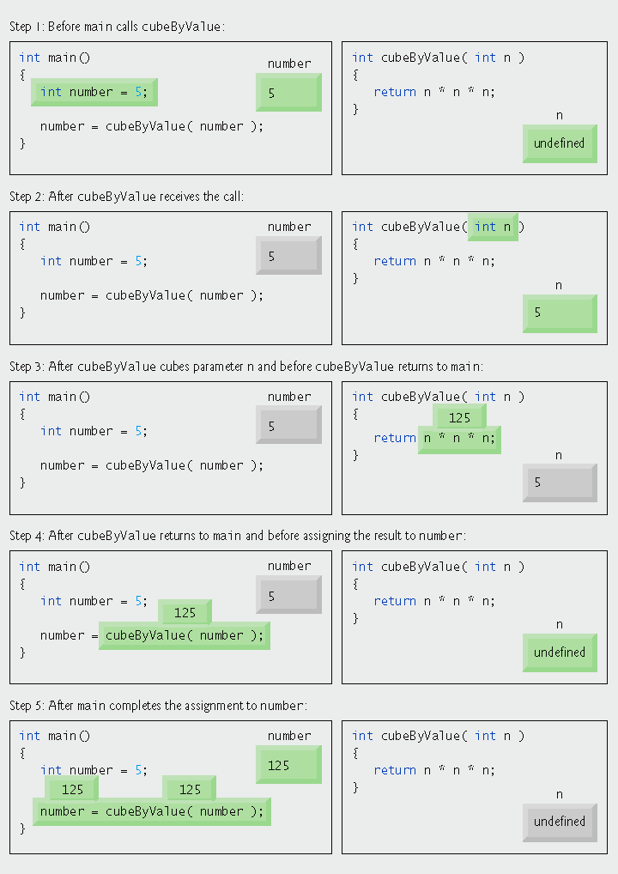
Fig. 8.8 | Pass-by-value analysis of the program of Fig. 8.6.

Slide 30
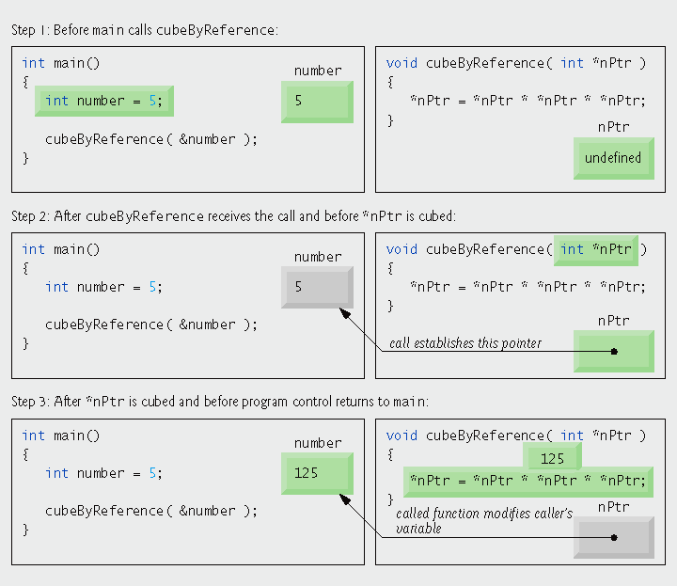
Fig. 8.9 | Pass-by-reference analysis (with a pointer argument) of the program of Fig. 8.7.

Slide 31
8.5 Using const with Pointers
const qualifier
  Indicates that value of variable should not be modified
  const used when function does not need to change the variable’s value
Principle of least privilege
  Award function enough access to accomplish task, but no more
  Example
    A function that prints the elements of an array, takes array and int indicating length
      Array contents are not changed – should be const
      Array length is not changed – should be const

Slide 32
Portability Tip 8.2
Although const is well defined in ANSI C and C++, some compilers do not enforce it properly. So a good rule is, “Know your compiler.”

Slide 33
Software Engineering Observation 8.2
If a value does not (or should not) change in the body of a function to which it is passed, the parameter should be declared const to ensure that it is not accidentally modified.

Slide 34
Error-Prevention Tip 8.2
Before using a function, check its function prototype to determine the parameters that it can modify.

Slide 35
8.5 Using const with Pointers (Cont.)
Four ways to pass pointer to function
  Nonconstant pointer to nonconstant data
    Highest amount of access
    Data can be modified through the dereferenced pointer
    Pointer can be modified to point to other data
      Pointer arithmetic
        Operator ++ moves array pointer to the next element
    Its declaration does not include const qualifier

Slide 36
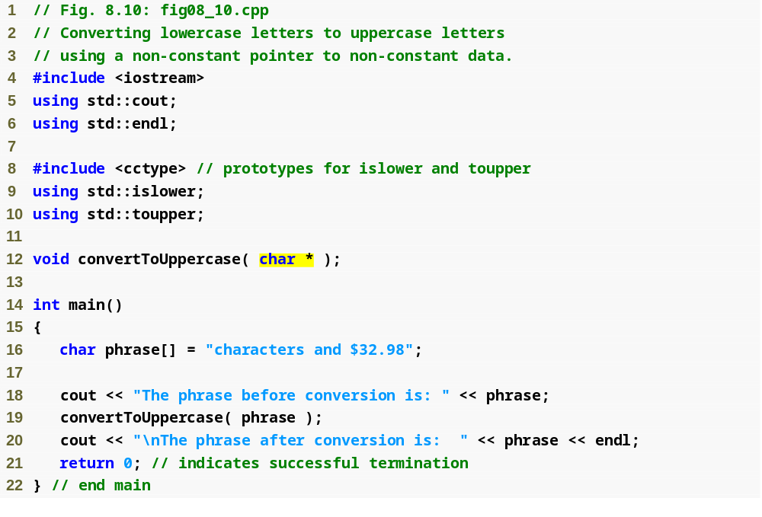
Outline
fig08_10.cpp
(1 of 2)
Parameter is a nonconstant pointer to nonconstant data
convertToUppercase modifies variable phrase

Slide 37
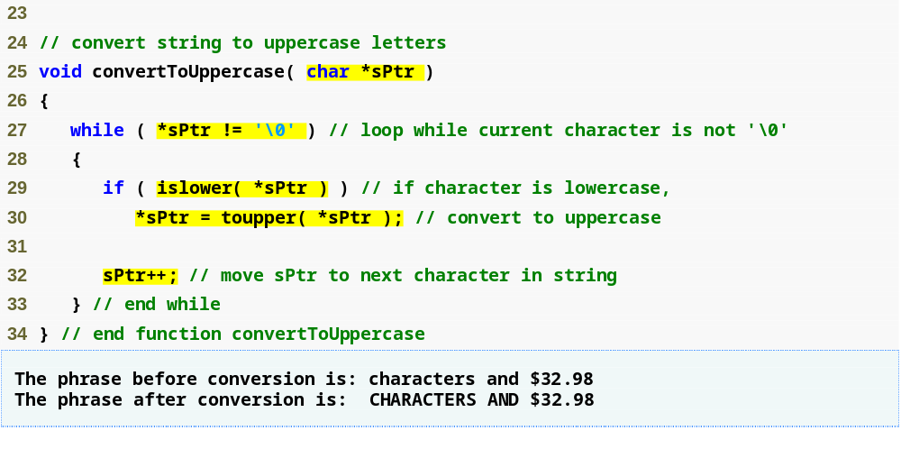
Outline
Parameter sPtr is a nonconstant pointer to nonconstant data
Function islower returns true if the character is lowercase
fig08_10.cpp
(2 of 2)
Function toupper returns corresponding uppercase character if original character is lowercase; otherwise toupper returns the original character
Modify the memory address stored in sPtr to point to the next element of the array

Slide 38
8.5 Using const with Pointers (Cont.)
Four ways to pass pointer to function (Cont.)
  Nonconstant pointer to constant data
    Pointer can be modified to point to any appropriate data item
    Data cannot be modified through this pointer
    Provides the performance of pass-by-reference and the protection of pass-by-value

Slide 39
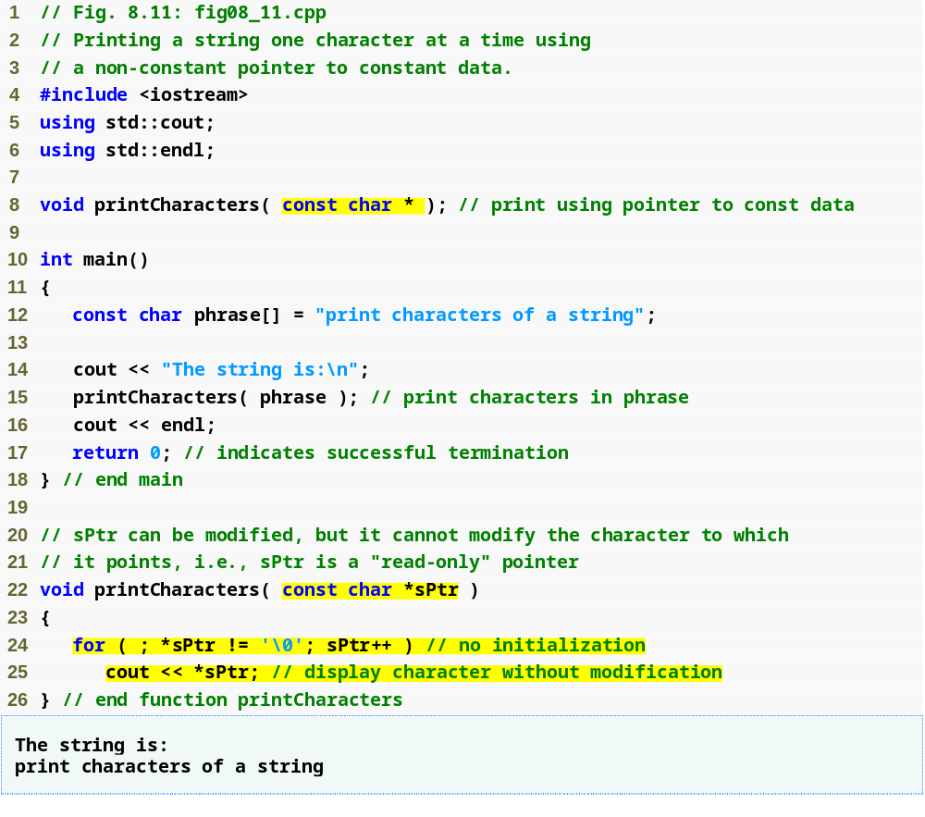
Outline
Parameter is a nonconstant pointer to constant data
fig08_11.cpp
(1 of 1)
Pass pointer phrase to function printCharacters
sPtr is a nonconstant pointer to constant data; it cannot modify the character to which it points
Increment sPtr to point to the next character

Slide 40
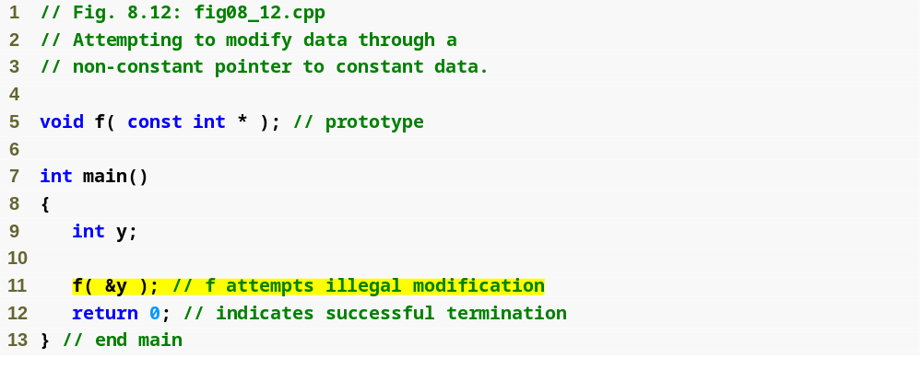
Outline
fig08_12.cpp
(1 of 2)
Parameter is a nonconstant pointer to constant data
Pass the address of int variable y to attempt an illegal modification

Slide 41
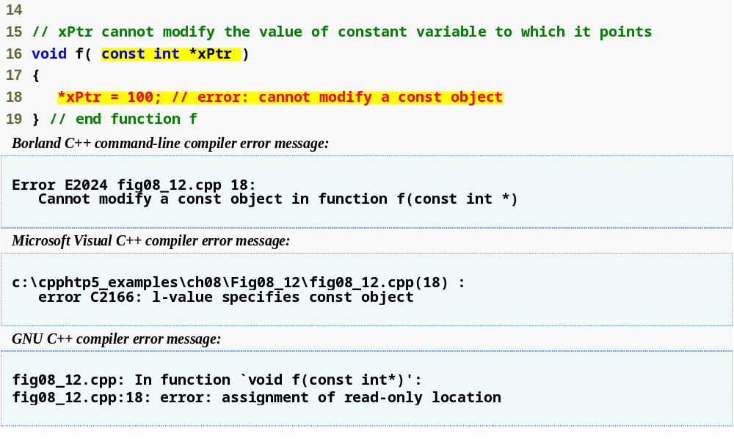
Outline
Attempt to modify a const object pointed to by xPtr
fig08_12.cpp
(2 of 2)
Error produced when attempting to compile

Slide 42
Performance Tip 8.1
If they do not need to be modified by the called function, pass large objects using pointers to constant data or references to constant data, to obtain the performance benefits of pass-by-reference.

Slide 43
Software Engineering Observation 8.3
Pass large objects using pointers to constant data, or references to constant data, to obtain the security of pass-by-value.

Slide 44
8.5 Using const with Pointers (Cont.)
Four ways to pass pointer to function (Cont.)
  Constant pointer to nonconstant data
    Always points to the same memory location
      Can only access other elements using subscript notation
    Data can be modified through the pointer
    Default for an array name
      Can be used by a function to receive an array argument
    Must be initialized when declared

Slide 45
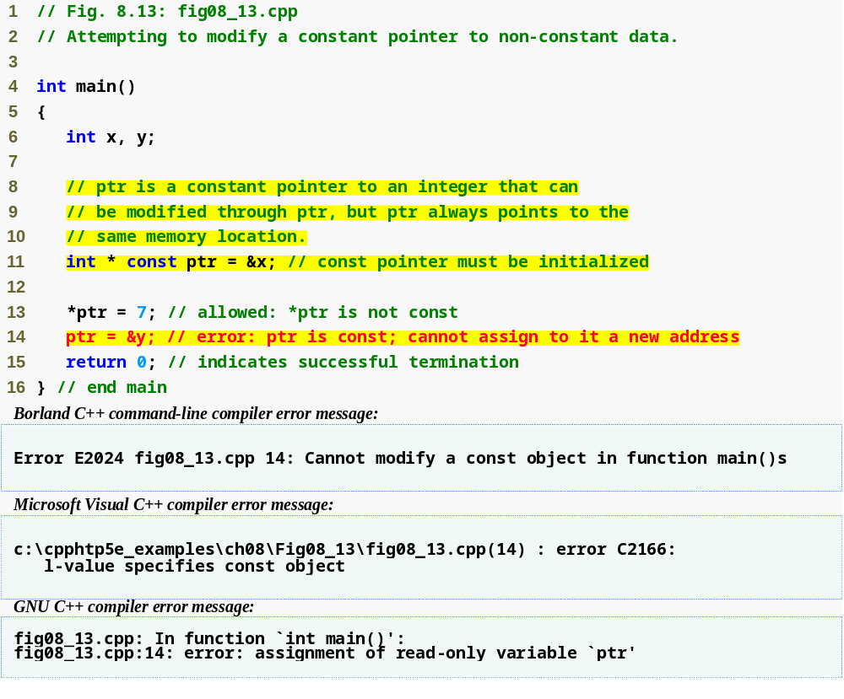
Outline
fig08_13.cpp
(1 of 1)
ptr is a constant pointer to an integer
Can modify x (pointed to by ptr) since x is not constant
Cannot modify ptr to point to a new address since ptr is constant
Line 14 generates a compiler error by attempting to assign a new address to a constant pointer

Slide 46
Common Programming Error 8.6
Not initializing a pointer that is declared const is a compilation error.

Slide 47
8.5 Using const with Pointers (Cont.)
Four ways to pass pointer to function (Cont.)
  Constant pointer to constant data
    Least amount of access
    Always points to the same memory location
    Data cannot be modified using this pointer

Slide 48
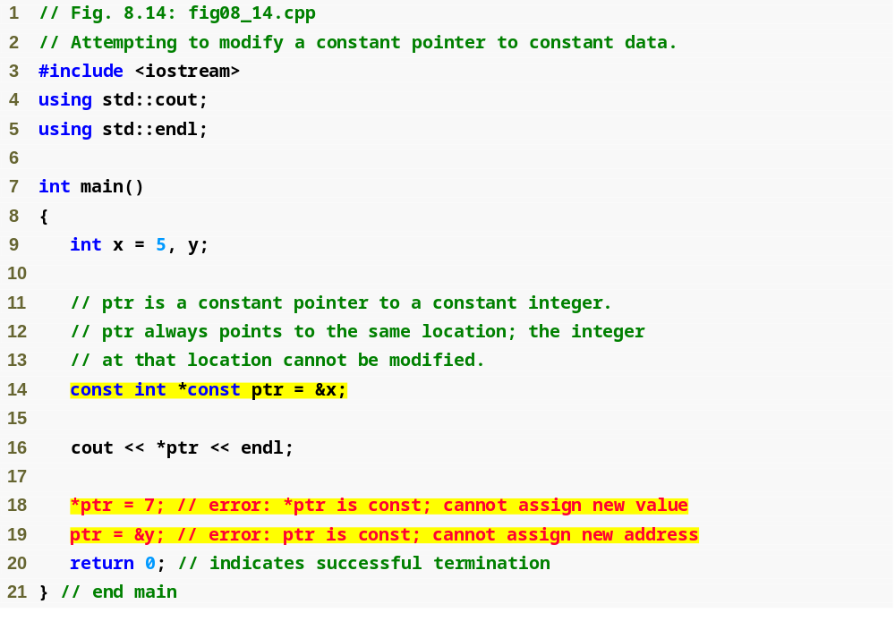
Outline
fig08_14.cpp
(1 of 2)
ptr is a constant pointer to a constant integer
Cannot modify x (pointed to by ptr) since *ptr is constant
Cannot modify ptr to point to a new address since ptr is constant

Slide 49
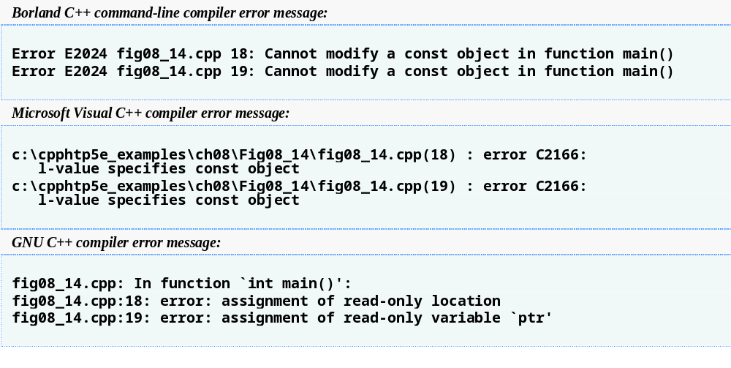
Outline
Line 18 generates a compiler error by attempting to modify a constant object
fig08_14.cpp
(2 of 2)
Line 19 generates a compiler error by attempting to assign a new address to a constant pointer

Slide 50
8.6 Selection Sort Using Pass-by-Reference
Implement selectionSort using pointers
  Selection sort algorithm
    Swap smallest element with the first element
    Swap second-smallest element with the second element
    Etc.
  Want function swap to access array elements
    Individual array elements: scalars
      Passed by value by default
    Pass by reference via pointers using address operator &

Slide 51
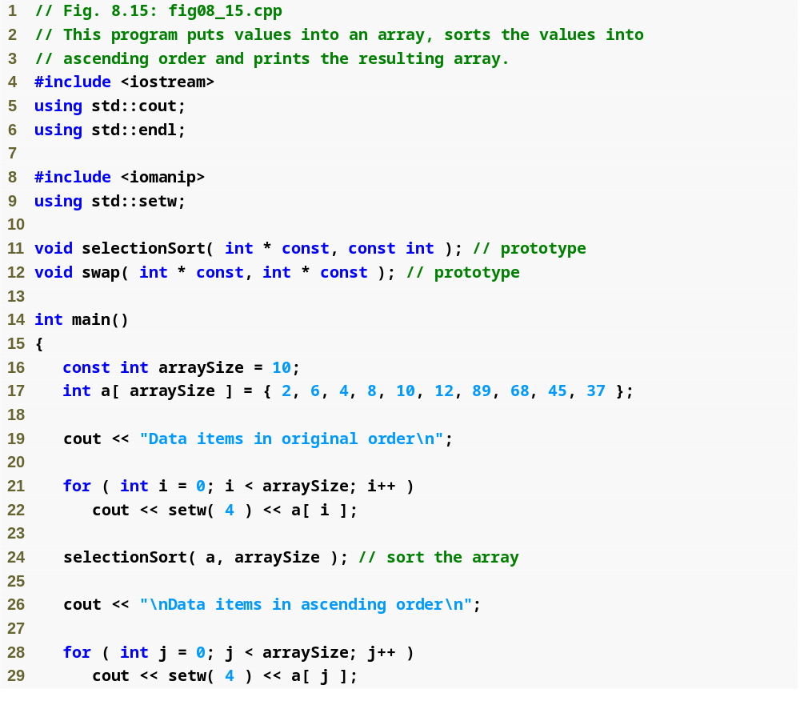
Outline
fig08_15.cpp
(1 of 3)

Slide 52
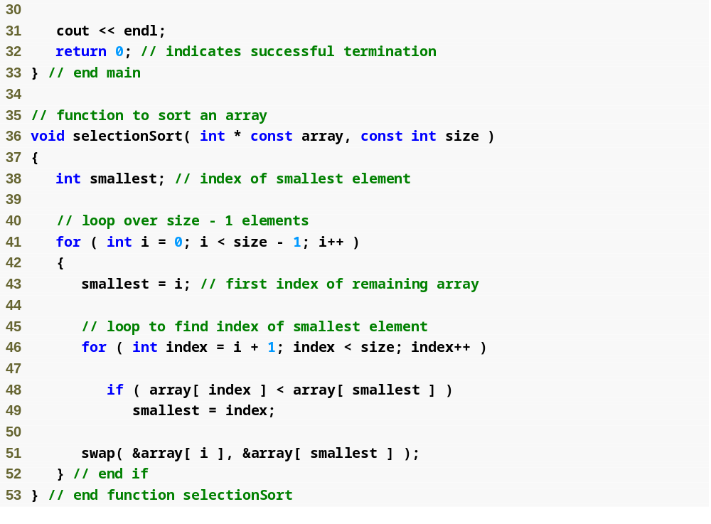
Outline
Declare array as int *array (rather than int array[]) to indicate function selectionSort receives single-subscripted array
fig08_15.cpp
(2 of 3)
Receives the size of the array as an argument; declared const to ensure that size is not modified

Slide 53
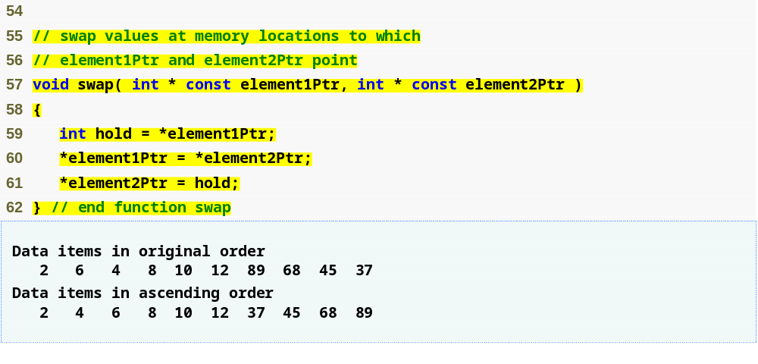
Outline
fig08_15.cpp
(3 of 3)
Arguments are assed by reference, allowing the function to swap values at the original memory locations

Slide 54
Software Engineering Observation 8.4
When passing an array to a function, also pass the size of the array (rather than building into the function knowledge of the array size). This makes the function more reusable.

Slide 55
8.7 sizeof Operators
sizeof operator
  Returns size of operand in bytes
  For arrays, sizeof returns
      ( size of 1 element ) * ( number of elements )
  If sizeof( int ) returns 4 then
  int myArray[ 10 ];
  cout << sizeof( myArray );
  will print 40
  Can be used with
    Variable names
    Type names
    Constant values

Slide 56
Common Programming Error 8.7
Using the sizeof operator in a function to find the size in bytes of an array parameter results in the size in bytes of a pointer, not the size in bytes of the array.

Slide 57
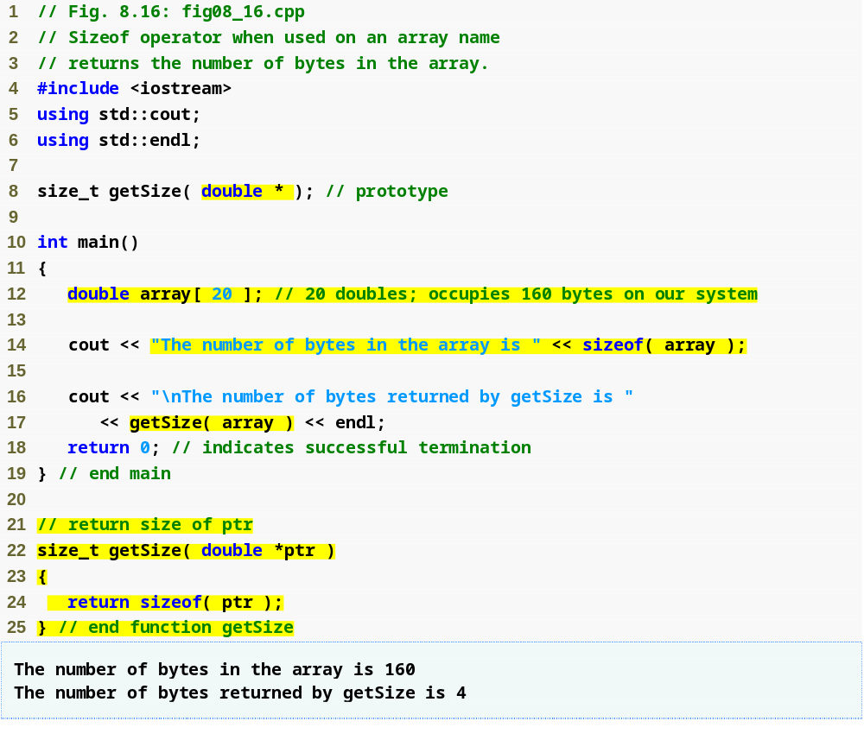
Outline
fig08_16.cpp
(1 of 1)
Operator sizeof applied to an array returns total number of bytes in the array
Function getSize returns the number of bytes used to store array address
Operator sizeof returns number of bytes of pointer

Slide 58
8.7 sizeof Operators (Cont.)
sizeof operator (Cont.)
  Is performed at compiler-time
  For double realArray[ 22 ];
    Use sizeof realArray / sizeof( double ) to calculate the number of elements in realArray
  Parentheses are only required if the operand is a type name

Slide 59
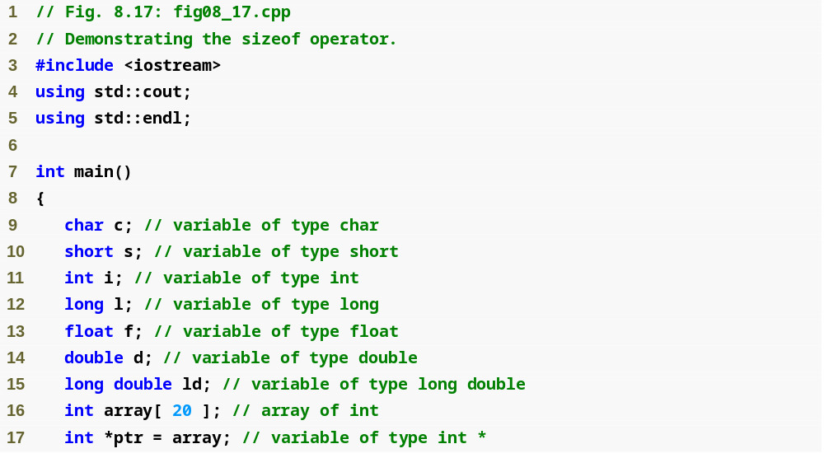
Outline
fig08_17.cpp
(1 of 2)

Slide 60
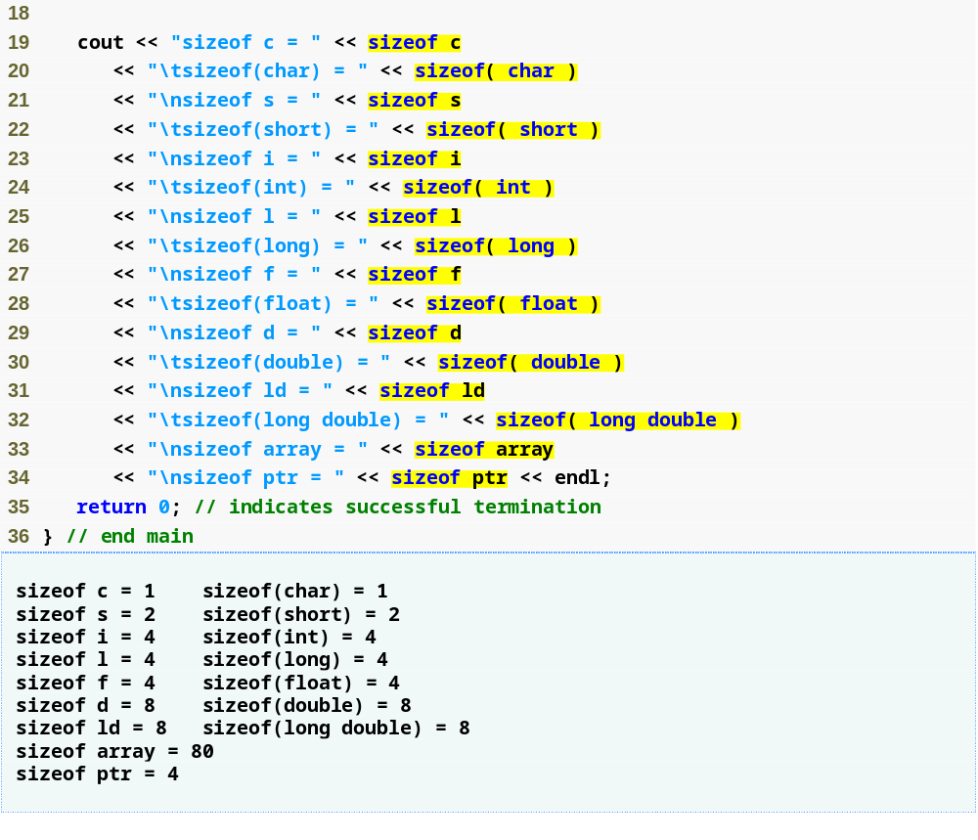
Outline
Operator sizeof can be used on a variable name
Operator sizeof can be used on a type name
fig08_17.cpp
(2 of 2)
Operator sizeof returns the total number of bytes in the array

Slide 61
Portability Tip 8.3
The number of bytes used to store a particular data type may vary between systems. When writing programs that depend on data type sizes, and that will run on several computer systems, use sizeof to determine the number of bytes used to store the data types.

Slide 62
Common Programming Error 8.8
Omitting the parentheses in a sizeof operation when the operand is a type name is a compilation error.

Slide 63
Performance Tip 8.2
Because sizeof is a compile-time unary operator, not an execution-time operator, using sizeof does not negatively impact execution performance.

Slide 64
Error-Prevention Tip 8.3
To avoid errors associated with omitting the parentheses around the operand of operator sizeof, many programmers include parentheses around every sizeof operand.

Slide 65
8.8 Pointer Expressions and Pointer Arithmetic
Pointer arithmetic
  Increment/decrement pointer (++ or --)
  Add/subtract an integer to/from a pointer (+ or +=,
  - or -=)
  Pointers may be subtracted from each other
  Pointer arithmetic is meaningless unless performed on a pointer to an array

Slide 66
8.8 Pointer Expressions and Pointer Arithmetic (Cont.)
5 element int array on a machine using 4 byte ints
  vPtr points to first element v[ 0 ], at location 3000
    vPtr = &v[ 0 ];
  vPtr += 2; sets vPtr to 3008 (3000 + 2 * 4)
    vPtr points to v[ 2 ]
Subtracting pointers
  Returns number of elements between two addresses
        vPtr2 = v[ 2 ];
        vPtr = v[ 0 ];
        vPtr2 - vPtr is 2

Slide 67
Portability Tip 8.4
Most computers today have two-byte or four-byte integers. Some of the newer machines use eight-byte integers. Because the results of pointer arithmetic depend on the size of the objects a pointer points to, pointer arithmetic is machine dependent.

Slide 68
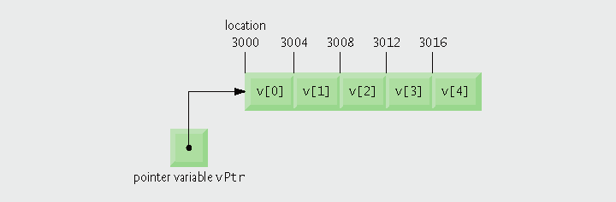
Fig. 8.18 | Array v and a pointer variable vPtr that points to v.

Slide 69
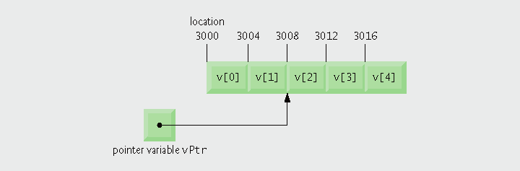
Fig. 8.19 | Pointer vPtr after pointer arithmetic.

Slide 70
Common Programming Error 8.9
Using pointer arithmetic on a pointer that does not refer to an array of values is a logic error.

Slide 71
Common Programming Error 8.10
Subtracting or comparing two pointers that do not refer to elements of the same array is a logic error.

Slide 72
Common Programming Error 8.11
Using pointer arithmetic to increment or decrement a pointer such that the pointer refers to an element past the end of the array or before the beginning of the array is normally a logic error.

Slide 73
8.8 Pointer Expressions and Pointer Arithmetic (Cont.)
Pointer assignment
  Pointer can be assigned to another pointer if both are of same type
    If not same type, cast operator must be used
    Exception
      Pointer to void (type void *)
        Generic pointer, represents any type
        No casting needed to convert pointer to void *
        Casting is needed to convert void * to any other type
        void pointers cannot be dereferenced

Slide 74
Software Engineering Observation 8.5
Nonconstant pointer arguments can be passed to constant pointer parameters. This is helpful when the body of a program uses a nonconstant pointer to access data, but does not want that data to be modified by a function called in the body of the program.

Slide 75
Common Programming Error 8.12
Assigning a pointer of one type to a pointer of another (other than void *) without casting the first pointer to the type of the second pointer is a compilation error.

Slide 76
Common Programming Error 8.13
All operations on a void * pointer are compilation errors, except comparing void * pointers with other pointers, casting void * pointers to valid pointer types and assigning addresses to void * pointers.

Slide 77
8.8 Pointer Expressions and Pointer Arithmetic (Cont.)
Pointer comparison
  Use equality and relational operators
  Compare addresses stored in pointers
    Comparisons are meaningless unless pointers point to members of the same array
  Example
    Could show that one pointer points to higher-index element of array than another pointer
  Commonly used to determine whether pointer is 0 (null pointer)

Slide 78
8.9 Relationship Between Pointers and Arrays
Arrays and pointers are closely related
  Array name is like constant pointer
  Pointers can do array subscripting operations

Slide 79
8.9 Relationship Between Pointers and Arrays (Cont.)
Accessing array elements with pointers
  Assume declarations:
  int b[ 5 ];
  int *bPtr;
  bPtr = b;
  Element b[ n ] can be accessed by *( bPtr + n )
    Called pointer/offset notation
  Addresses
    &b[ 3 ] is same as bPtr + 3
  Array name can be treated as pointer
    b[ 3 ] is same as *( b + 3 )
  Pointers can be subscripted (pointer/subscript notation)
    bPtr[ 3 ] is same as b[ 3 ]

Slide 80
Common Programming Error 8.14
Although array names are pointers to the beginning of the array and pointers can be modified in arithmetic expressions, array names cannot be modified in arithmetic expressions, because array names are constant pointers.

Slide 81
Good Programming Practice 8.2
For clarity, use array notation instead of pointer notation when manipulating arrays.

Slide 82
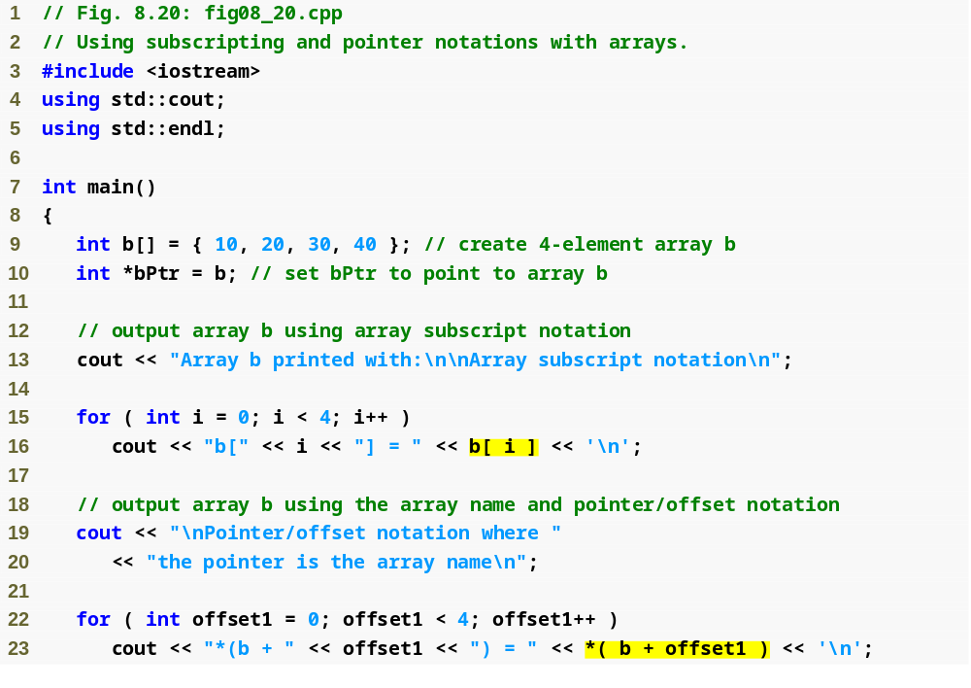
Outline
fig08_20.cpp
(1 of 3)
Using array subscript notation
Using array name and pointer/offset notation

Slide 83
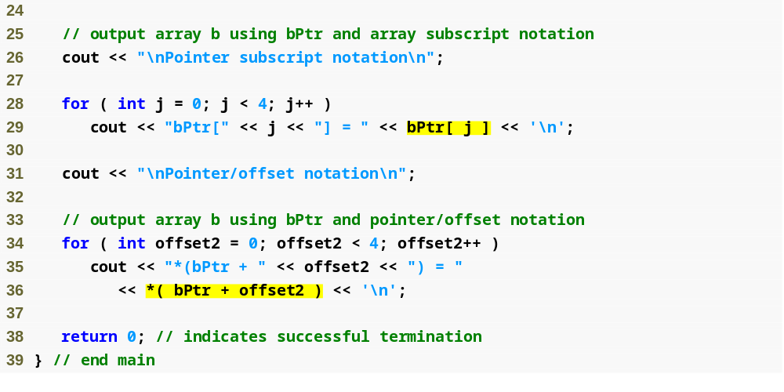
Outline
fig08_20.cpp
(2 of 3)
Using pointer subscript notation
Using pointer name and pointer/offset notation

Slide 84
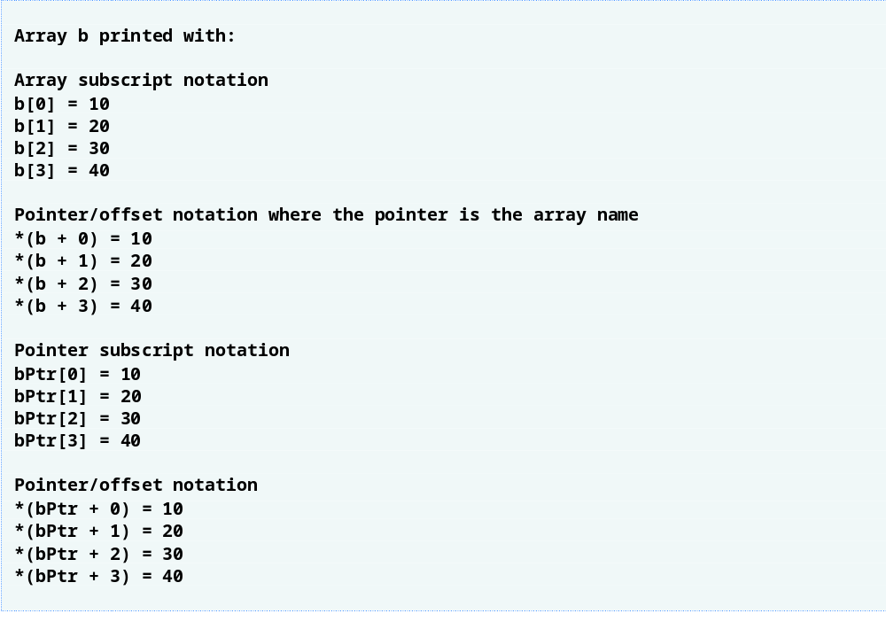
Outline
fig08_20.cpp
(3 of 3)

Slide 85
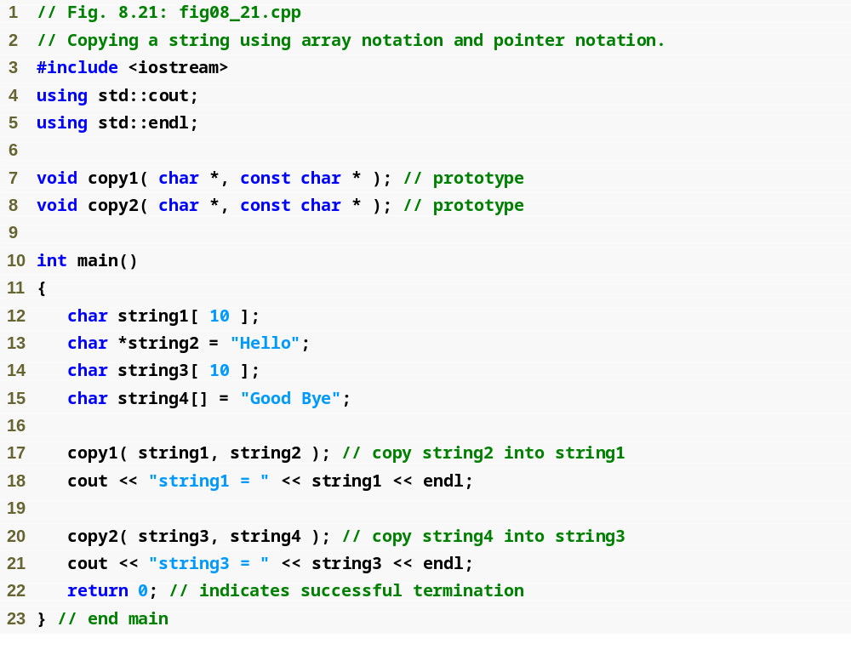
Outline
fig08_21.cpp
(1 of 2)

Slide 86
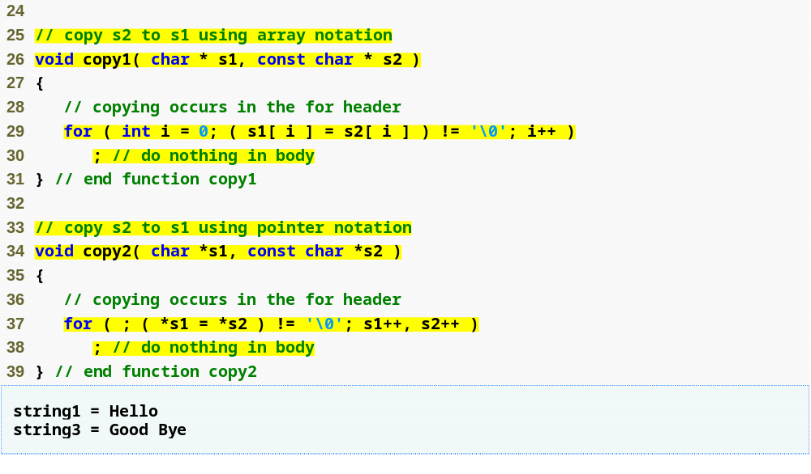
Outline
Use array subscript notation to copy string in s2 to character array s1
fig08_21.cpp
(2 of 2)
Use pointer notation to copy string in s2 to character array in s1
Increment both pointers to point to next elements in corresponding arrays

Slide 87
8.10 Arrays of Pointers
Arrays can contain pointers
  Commonly used to store array of strings (string array)
    Array does not store strings, only pointers to strings
    Example
      const char *suit[ 4 ] =
      { "Hearts", "Diamonds", "Clubs", "Spades" };
        Each element of suit points to a char * (string)
    suit array has fixed size (4), but strings can be of any size
    Commonly used with command-line arguments to function main

Slide 88
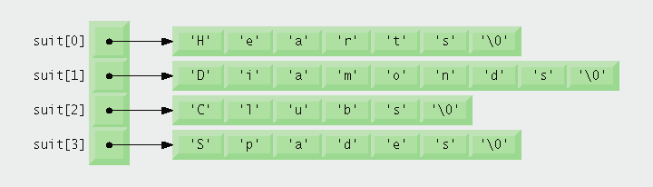
Fig. 8.22 | Graphical representation of the suit array.

Slide 89
8.11 Case Study: Card Shuffling and Dealing Simulation
Card shuffling program
  Use an array of pointers to strings, to store suit names
  Use a double scripted array (suit-by-value)
  Place 1-52 into the array to specify the order in which the cards are dealt
Indefinite postponement (starvation)
  An algorithm executing for an indefinitely long period
    Due to randomness

Slide 90
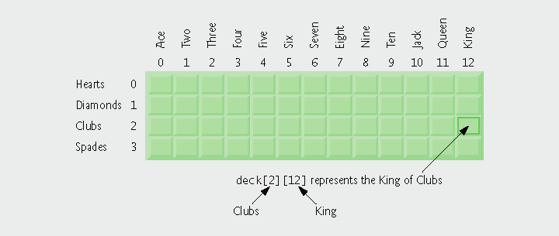
Fig. 8.23 | Two-dimensional array representation of a deck of cards.

Slide 91
Performance Tip 8.3
Sometimes algorithms that emerge in a “natural” way can contain subtle performance problems such as indefinite postponement. Seek algorithms that avoid indefinite postponement.

Slide 92
8.11 Case Study: Card Shuffling and Dealing Simulation (Cont.)
Pseudocode for shuffling and dealing
simulation
First refinement
Second refinement
Third refinement
Initialize the suit array
Initialize the face array
Initialize the deck array
Shuffle the deck
Deal 52 cards
For each of the 52 cards
  Place card number in randomly selected unoccupied slot of deck
Choose slot of deck randomly
While chosen slot of deck has
been previously chosen
Choose slot of deck randomly
  Place card number in chosen slot of deck
For each of the 52 cards
  Find card number in deck array and print face and suit of card
For each slot of the deck array
If slot contains card number
Print the face and suit of the
card

Slide 93
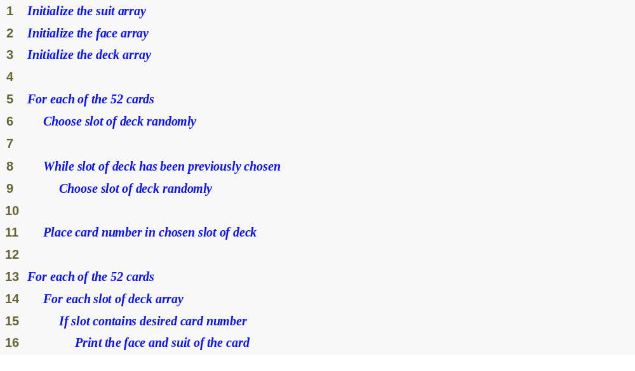
Outline
fig08_24.cpp
(1 of 1)

Slide 94
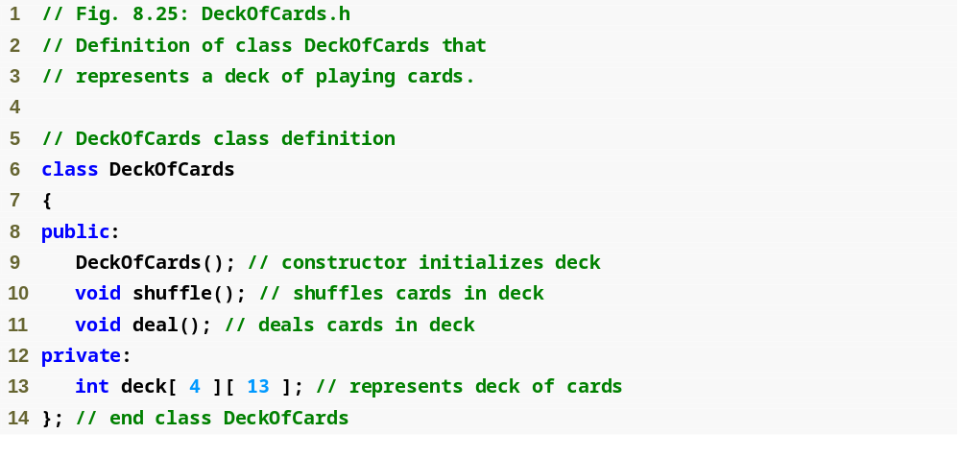
Outline
fig08_25.cpp
(1 of 1)

Slide 95
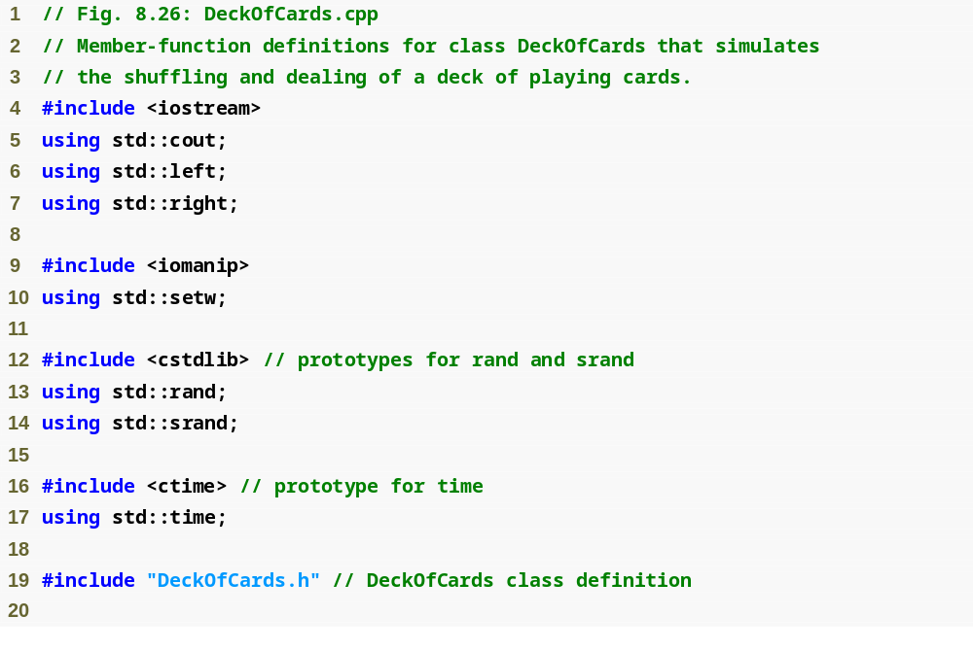
Outline
fig08_26.cpp
(1 of 4)

Slide 96
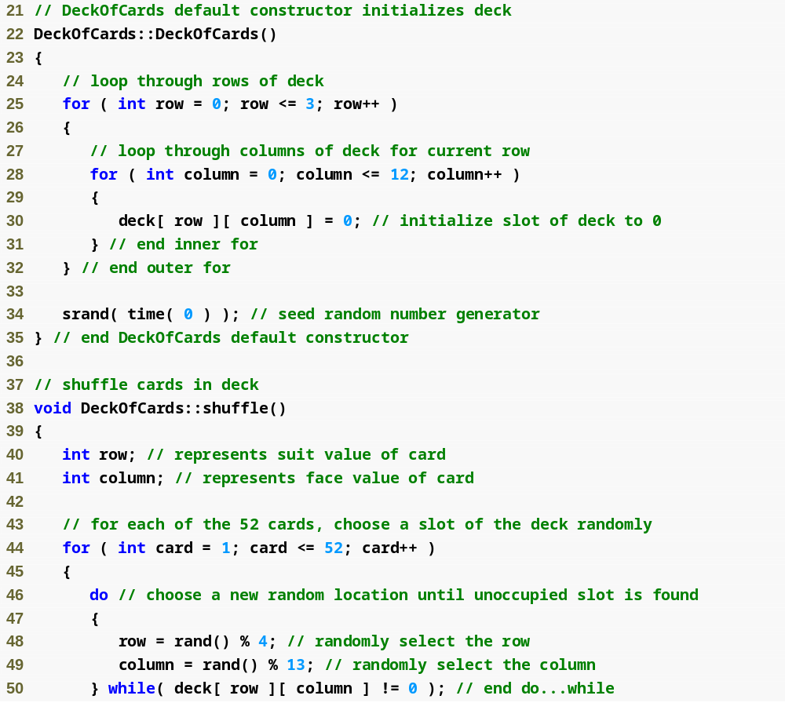
Outline
fig08_26.cpp
(2 of 4)
Current position is at randomly selected row and column

Slide 97
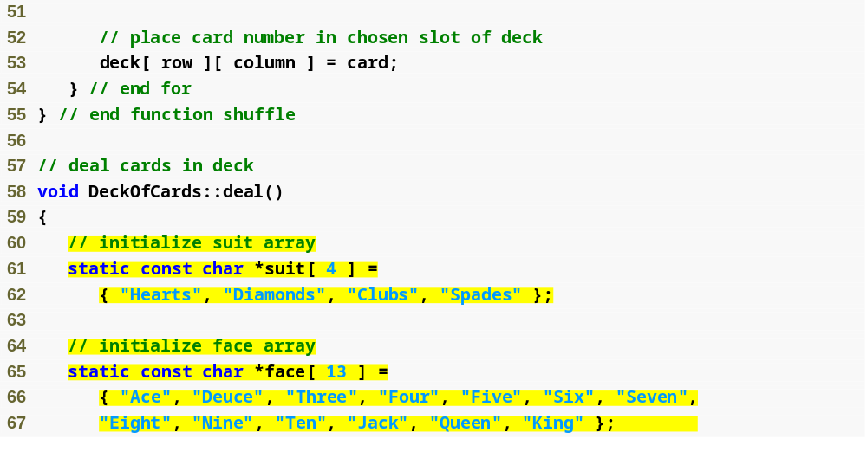
Outline
fig08_26.cpp
(3 of 4)
suit array contains pointers to char arrays
face array contains pointers to char arrays

Slide 98
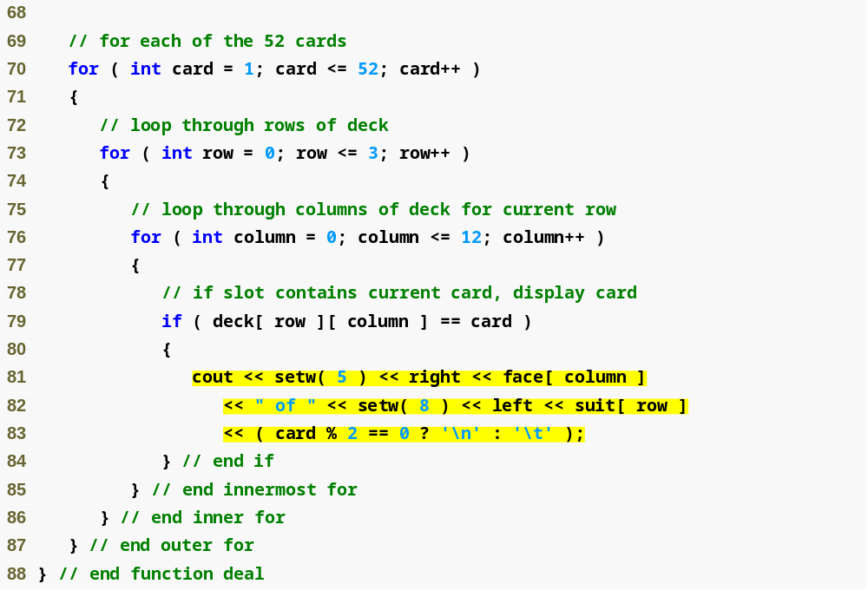
Outline
fig08_26.cpp
(4 of 4)
Cause face to be output right justified in field of 5 characters
Cause suit to be output left justified in field of 8 characters

Slide 99
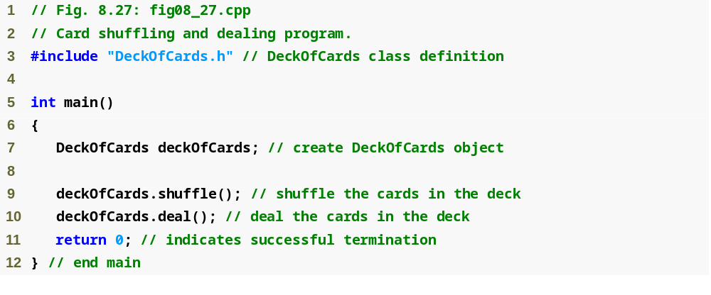
Outline
fig08_27.cpp
(1 of 2)

Slide 100
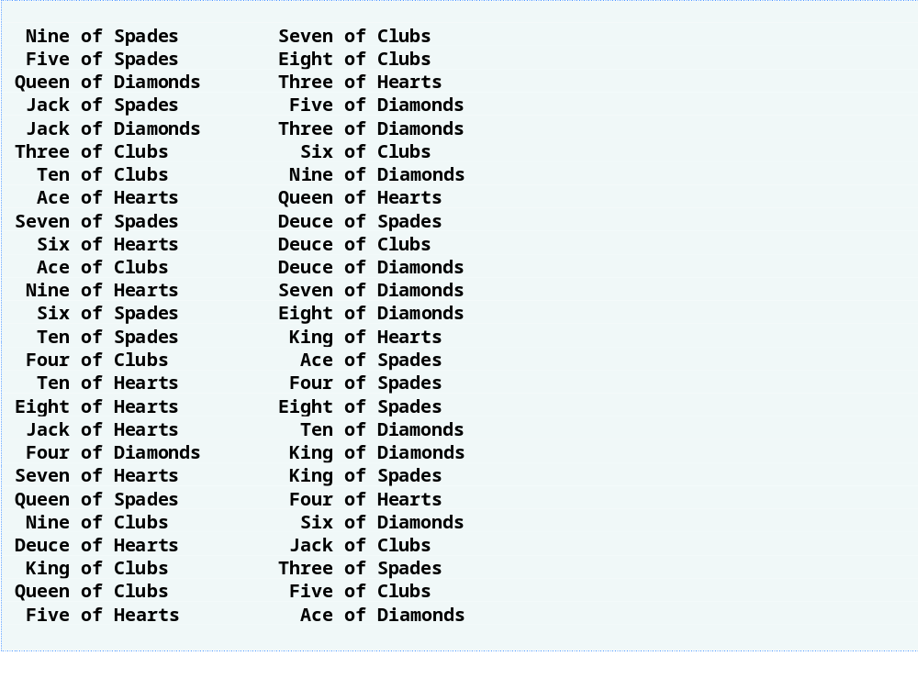
Outline
fig08_27.cpp
(2 of 2)

Slide 101
8.12 Function Pointers
Pointers to functions
  Contain addresses of functions
    Similar to how array name is address of first element
    Function name is starting address of code that defines function
Function pointers can be
  Passed to functions
  Returned from functions
  Stored in arrays
  Assigned to other function pointers

Slide 102
8.12 Function Pointers (Cont.)
Calling functions using pointers
  Assume function header parameter:
    bool ( *compare ) ( int, int )
  Execute function from pointer with either
    ( *compare ) ( int1, int2 )
      Dereference pointer to function
  OR
    compare( int1, int2 )
      Could be confusing
        User may think compare is name of actual function in program

Slide 103
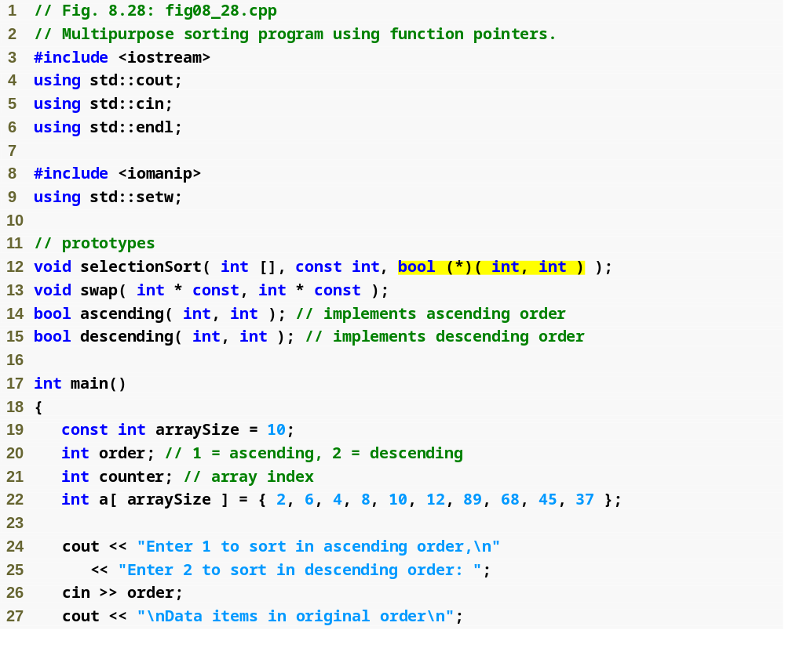
Outline
fig08_28.cpp
(1 of 4)
Parameter is pointer to function that receives two integer parameters and returns bool result

Slide 104
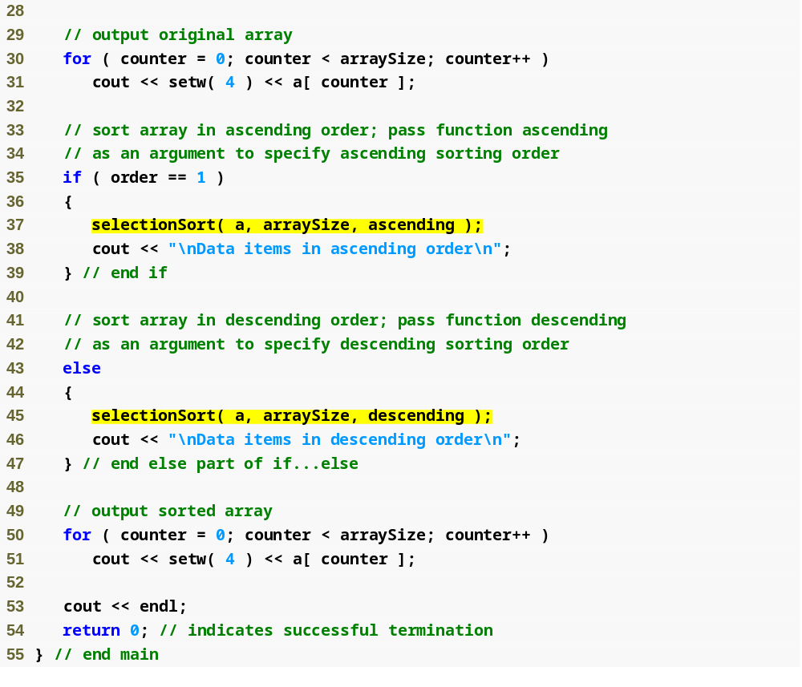
Outline
fig08_28.cpp
(2 of 4)
Pass pointers to functions ascending and descending as parameters to function selectionSort

Slide 105
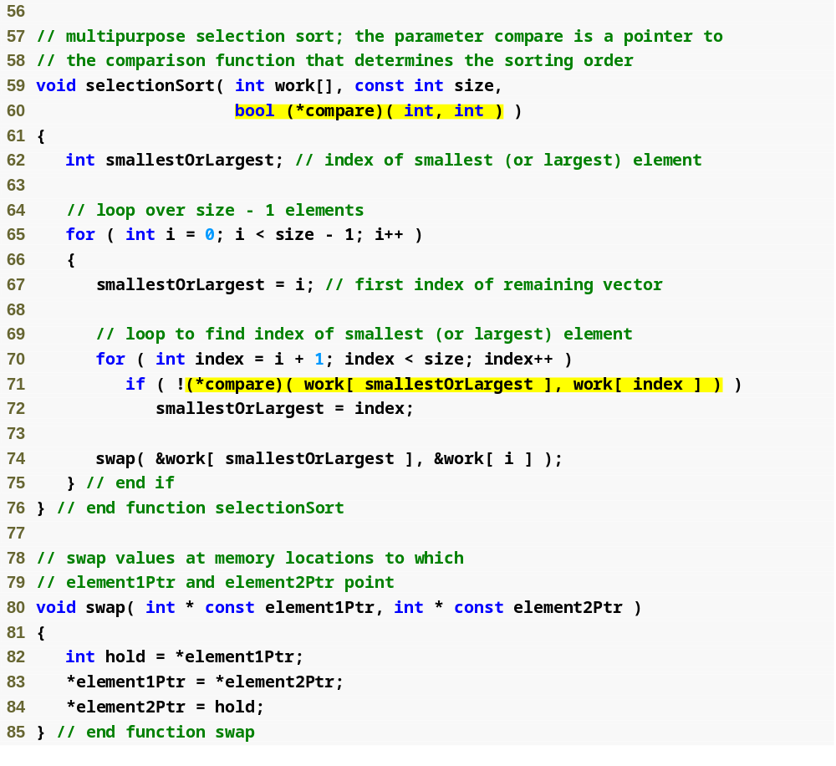
Outline
compare is a pointer to a function that receives two integer parameters and returns a bool result
fig08_28.cpp
(3 of 4)
Parentheses necessary to indicate pointer to function
Dereference pointer compare to execute the function

Slide 106
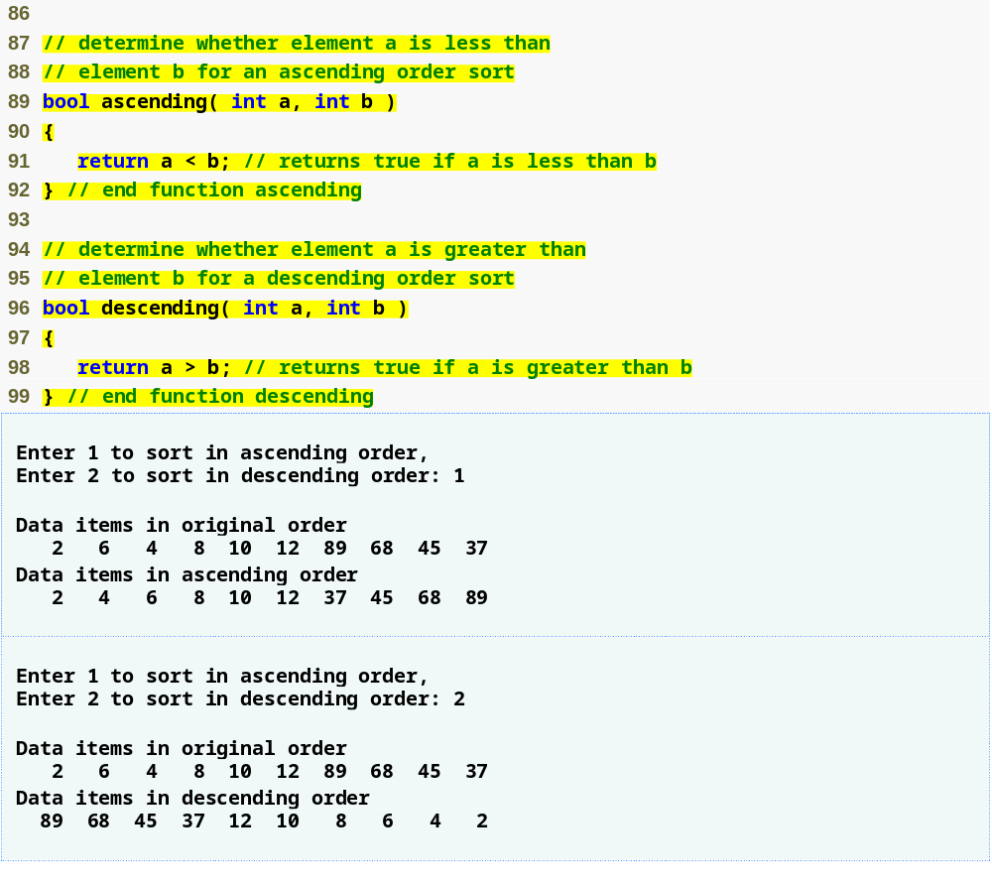
Outline
fig08_28.cpp
(4 of 4)

Slide 107
8.12 Function Pointers (Cont.)
Arrays of pointers to functions
  Menu-driven systems
    Pointers to each function stored in array of pointers to functions
      All functions must have same return type and same parameter types
    Menu choice determines subscript into array of function pointers

Slide 108
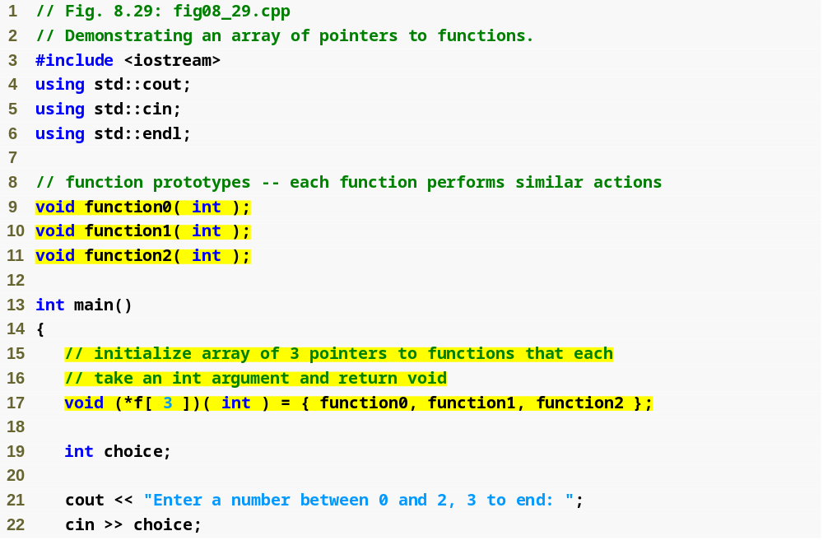
Outline
fig08_29.cpp
(1 of 3)
Array initialized with names of three functions

Slide 109
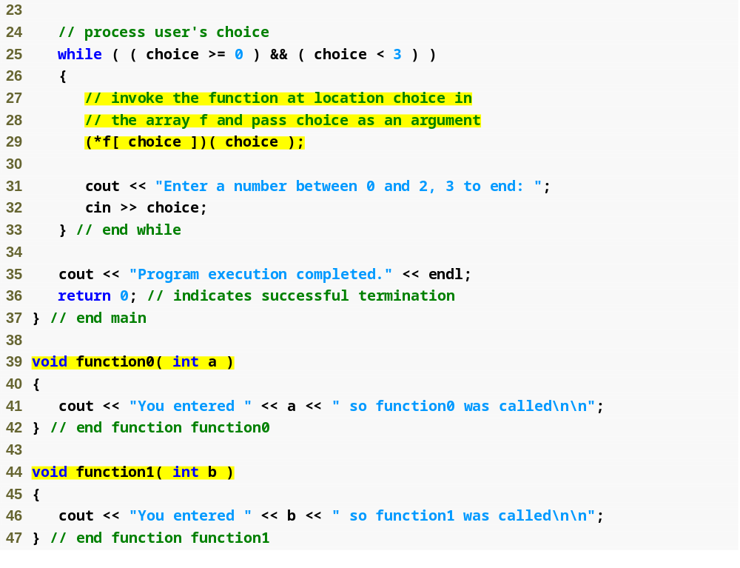
Outline
fig08_29.cpp
(2 of 3)
Call chosen function by dereferencing corresponding element in array

Slide 110
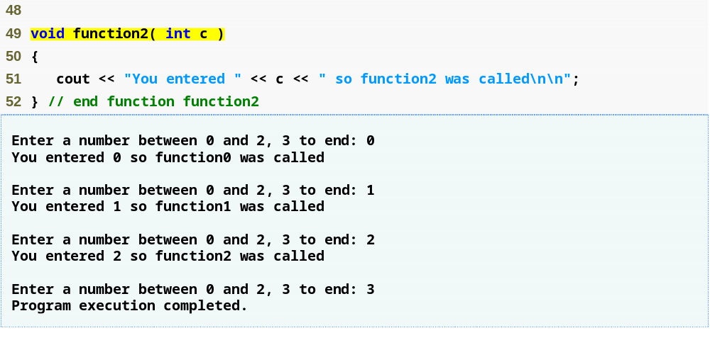
Outline
fig08_29.cpp
(3 of 3)

Slide 111
8.13 Introduction to Pointer-Based String Processing
Standard Library functions for string processing
  Appropriate for developing text-processing software

Slide 112
8.13.1 Fundamentals of Characters and Pointer-Based Strings
Character constant
  Integer value represented as character in single quotes
    Example
      'z' is integer value of z
        122 in ASCII
      '\n' is integer value of newline
        10 in ASCII

Slide 113
8.13.1 Fundamentals of Characters and Pointer-Based Strings (Cont.)
String
  Series of characters treated as single unit
  Can include letters, digits, special characters +, -, *, ...
  String literal (string constants)
    Enclosed in double quotes, for example:
        "I like C++“
    Have static storage class
  Array of characters, ends with null character '\0'
  String is constant pointer
    Pointer to string’s first character
      Like arrays

Slide 114
8.13.1 Fundamentals of Characters and Pointer-Based Strings (Cont.)
String assignment
  Character array
    char color[] = "blue";
      Creates 5 element char array color
        Last element is '\0'
  Variable of type char *
    char *colorPtr = "blue";
      Creates pointer colorPtr to letter b in string "blue"
        "blue" somewhere in memory
  Alternative for character array
    char color[] = { 'b', 'l', 'u', 'e', '\0' };

Slide 115
Common Programming Error 8.15
Not allocating sufficient space in a character array to store the null character that terminates a string is an error.

Slide 116
Common Programming Error 8.16
Creating or using a C-style string that does not contain a terminating null character can lead to logic errors.

Slide 117
Error-Prevention Tip 8.4
When storing a string of characters in a character array, be sure that the array is large enough to hold the largest string that will be stored. C++ allows strings of any length to be stored. If a string is longer than the character array in which it is to be stored, characters beyond the end of the array will overwrite data in memory following the array, leading to logic errors.

Slide 118
8.13.1 Fundamentals of Characters and Pointer-Based Strings (Cont.)
Reading strings
  Assign input to character array word[ 20 ]
    cin >> word;
      Reads characters until whitespace or EOF
  String could exceed array size
    cin >> setw( 20 ) >> word;
      Reads only up to 19 characters (space reserved for '\0')

Slide 119
8.13.1 Fundamentals of Characters and Pointer-Based Strings (Cont.)
cin.getline
  Read line of text
    cin.getline( array, size, delimiter );
      Copies input into specified array until either
        One less than size is reached
        delimiter character is input
    Example
      char sentence[ 80 ];
      cin.getline( sentence, 80, '\n' );

Slide 120
Common Programming Error 8.17
Processing a single character as a char * string can lead to a fatal runtime error. A char * string is a pointer—probably a respectably large integer. However, a character is a small integer (ASCII values range 0–255). On many systems, dereferencing a char value causes an error, because low memory addresses are reserved for special purposes such as operating system interrupt handlers—so “memory access violations” occur.

Slide 121
Common Programming Error 8.18
Passing a string as an argument to a function when a character is expected is a compilation error.

Slide 122
8.13.2 String Manipulation Functions of the String-Handling Library
String handling library <cstring> provides functions to
  Manipulate string data
  Compare strings
  Search strings for characters and other strings
  Tokenize strings (separate strings into logical pieces)
Data type size_t
  Defined to be an unsigned integral type
    Such as unsigned int or unsigned long
  In header file <cstring>

Slide 123
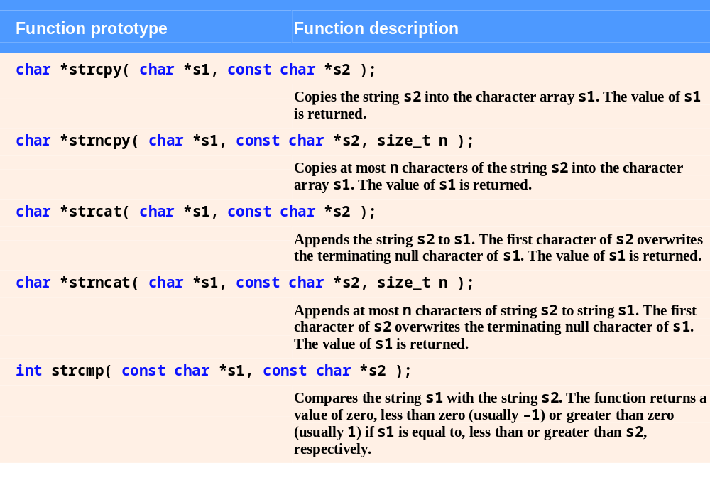
Fig. 8.30 | String-manipulation functions of the string-handling library. (Part 1 of 2)

Slide 124
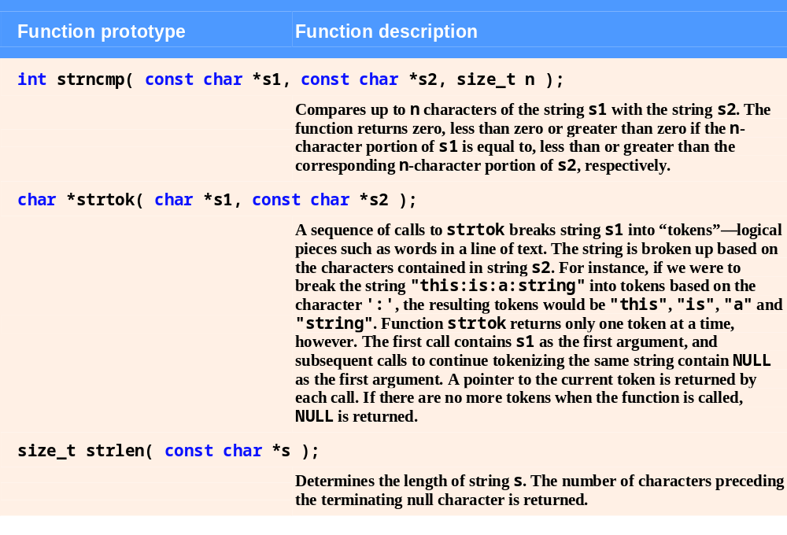
Fig. 8.30 | String-manipulation functions of the string-handling library. (Part 2 of 2)

Slide 125
Common Programming Error 8.19
Forgetting to include the <cstring> header file when using functions from the string-handling library causes compilation errors.

Slide 126
8.13.2 String Manipulation Functions of the String-Handling Library (Cont.)
Copying strings
  char *strcpy( char *s1, const char *s2 )
    Copies second argument into first argument
      First argument must be large enough to store string and terminating null character
  char *strncpy( char *s1, const char *s2, size_t n )
    Specifies number of characters to be copied from second argument into first argument
      Does not necessarily copy terminating null character

Slide 127
Common Programming Error 8.20
When using strncpy, the terminating null character of the second argument (a char * string) will not be copied if the number of characters specified by strncpy’s third argument is not greater than the second argument’s length. In that case, a fatal error may occur if the programmer does not manually terminate the resulting char * string with a null character.

Slide 128
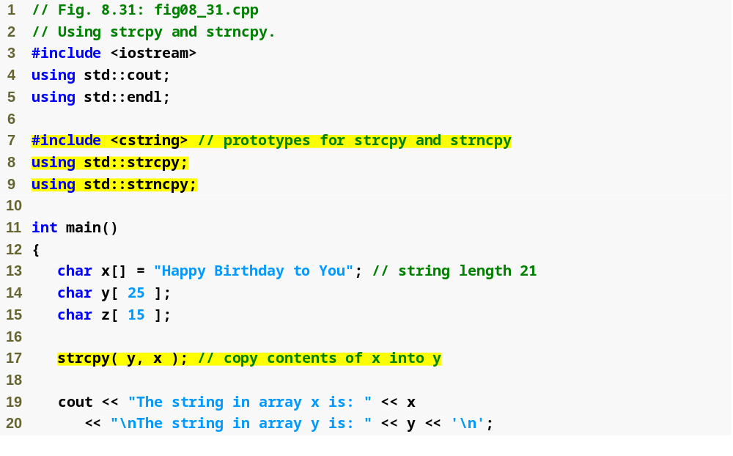
Outline
fig08_31.cpp
(1 of 2)
<cstring> contains prototypes for strcpy and strncpy
Copy entire string in array x into array y

Slide 129
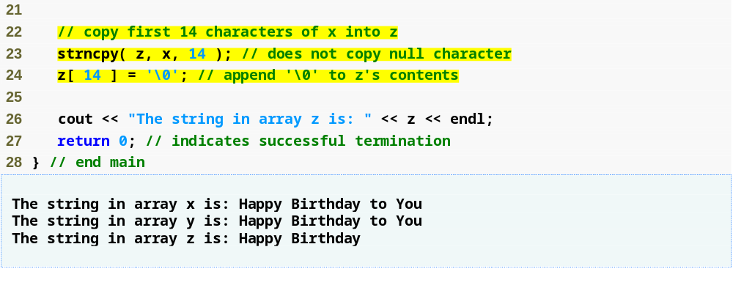
Outline
Copy first 14 characters of array x into array y. Note that this does not write terminating null character
fig08_31.cpp
(2 of 2)
Append terminating null character
String to copy
Copied string using strcpy
Copied first 14 characters using strncpy

Slide 130
8.13.2 String Manipulation Functions of the String-Handling Library (Cont.)
Concatenating strings
  char *strcat( char *s1, const char *s2 )
    Appends second argument to first argument
      First character of second argument replaces null character terminating first argument
      You must ensure first argument large enough to store concatenated result and null character
  char *strncat( char *s1, const char *s2, size_t n )
    Appends specified number of characters from second argument to first argument
      Appends terminating null character to result

Slide 131

Outline
fig08_32.cpp
(1 of 2)
<cstring> contains prototypes for strcat and strncat
Append s2 to s1
Append first 6 characters of s1 to s3

Slide 132

Outline
Append s1 to s3
fig08_32.cpp
(2 of 2)

Slide 133
8.13.2 String Manipulation Functions of the String-Handling Library (Cont.)
Comparing strings
  int strcmp( const char *s1, const char *s2 )
    Compares character by character
    Returns
      Zero if strings are equal
      Negative value if first string is less than second string
      Positive value if first string is greater than second string
  int strncmp( const char *s1,
  const char *s2, size_t n )
    Compares up to specified number of characters
      Stops if it reaches null character in one of arguments

Slide 134
Common Programming Error 8.21
Assuming that strcmp and strncmp return one (a true value) when their arguments are equal is a logic error. Both functions return zero (C++'s false value) for equality. Therefore, when testing two strings for equality, the result of the strcmp or strncmp function should be compared with zero to determine whether the strings are equal.

Slide 135

Outline
fig08_33.cpp
(1 of 2)
<cstring> contains prototypes for strcmp and strncmp
Compare s1 and s2
Compare s1 and s3
Compare s3 and s1
Compare up to 6 characters of s1 and s3
Compare up to 7 characters of s1 and s3
Compare up to 7 characters of s3 and s1

Slide 136

Outline
fig08_33.cpp
(2 of 2)

Slide 137
8.13.2 String Manipulation Functions of the String-Handling Library (Cont.)
Comparing strings (Cont.)
  Characters represented as numeric codes
    Strings compared using numeric codes
  Character codes / character sets
    ASCII
      “American Standard Code for Information Interchage”
    EBCDIC
      “Extended Binary Coded Decimal Interchange Code”
    Unicode

Slide 138
Portability Tip 8.5
The internal numeric codes used to represent characters may be different on different computers, because these computers may use different character sets.

Slide 139
Portability Tip 8.6
Do not explicitly test for ASCII codes, as in if ( rating == 65 ); rather, use the corresponding character constant, as in if ( rating == 'A' ).

Slide 140
8.13.2 String Manipulation Functions of the String-Handling Library (Cont.)
Tokenizing
  Breaking strings into tokens
    Tokens usually logical units, such as words (separated by spaces)
    Separated by delimiting characters
  Example
    "This is my string" has 4 word tokens (separated by spaces)

Slide 141
8.13.2 String Manipulation Functions of the String-Handling Library (Cont.)
Tokenizing (Cont.)
  char *strtok( char *s1, const char *s2 )
    Multiple calls required
      First call contains two arguments, string to be tokenized and string containing delimiting characters
        Finds next delimiting character and replaces with null character
      Subsequent calls continue tokenizing
        Call with first argument NULL
        Stores pointer to remaining string in a static variable
    Returns pointer to current token

Slide 142

Outline
fig08_34.cpp
(1 of 2)
<cstring> contains prototype for strtok
First call to strtok begins tokenization
Subsequent calls to strtok with NULL as first argument to indicate continuation

Slide 143

Outline
fig08_34.cpp
(2 of 2)

Slide 144
Common Programming Error 8.22
Not realizing that strtok modifies the string being tokenized and then attempting to use that string as if it were the original unmodified string is a logic error.

Slide 145
8.13.2 String Manipulation Functions of the String-Handling Library (Cont.)
Determining string lengths
  size_t strlen( const char *s )
    Returns number of characters in string
      Terminating null character is not included in length
      This length is also the index of the terminating null character

Slide 146

Outline
fig08_35.cpp
(1 of 1)
<cstring> contains prototype for strlen
Using strlen to determine length of strings

